Slide 1

WEEK 3
CESAR A. PASCAL

Slide 2
This week, I prioritized evaluating whether the Unitree G1 model is capable of reproducing movement patterns from the dataset collected last week. Once the replication workflow was tested, I used the dataset to train a neural network model that maps recorded inputs to motion outputs. The next step was implementing the trained model inside MuJoCo, with the goal of running inference in simulation and using the model’s outputs to drive the G1’s control commands.

Slide 3
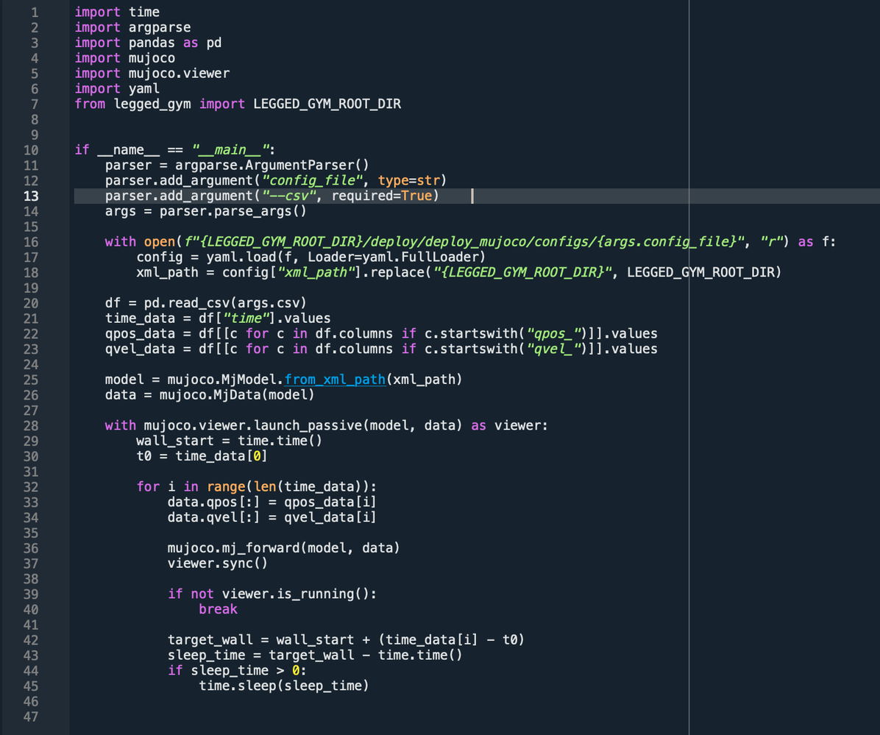

Slide 4
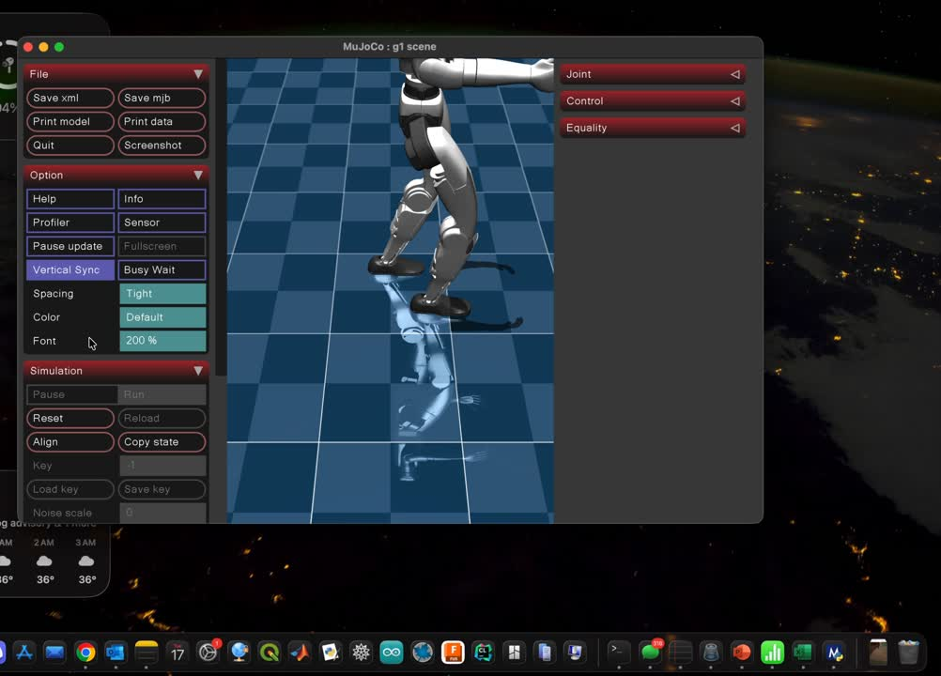
This approach worked perfectly, as the robot was able to replicate the exact same behavior by simply reading the motion data from the CSV file. This confirms that the recorded data is consistent and correctly mapped to the G1 model, validating the data pipeline before moving on to neural network training and simulation deployment.

Slide 5
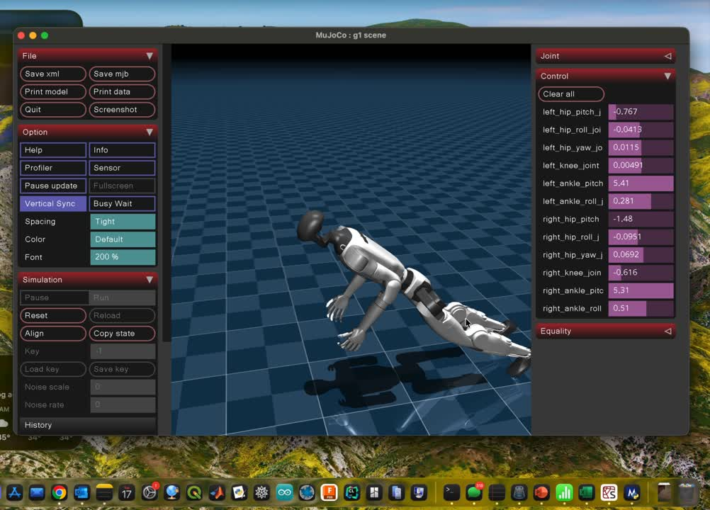
With the data validated, I proceeded to train a neural network model using the recorded motion data as input. The goal was to learn the underlying movement patterns so the model could reproduce the behavior without explicitly reading from the CSV file.

Slide 6
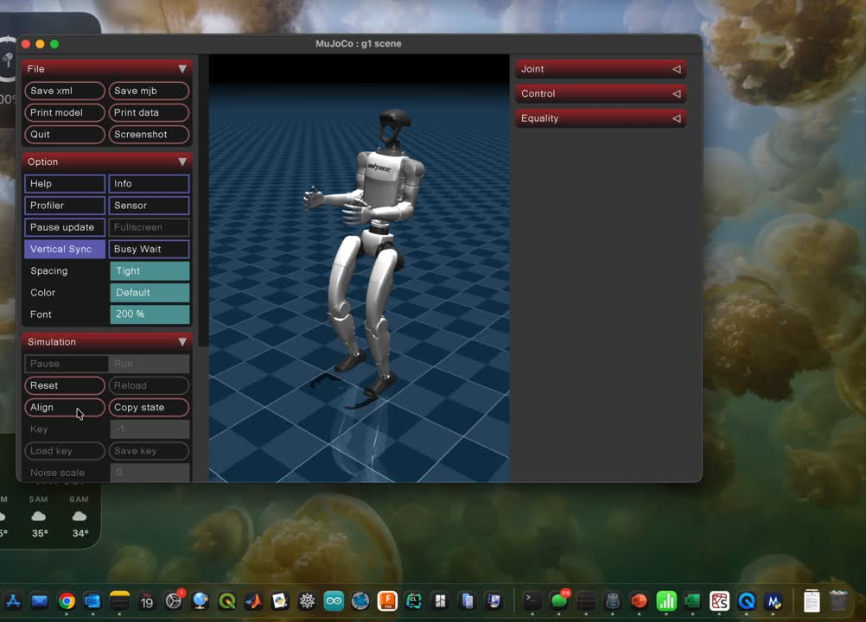
This more advanced model required approximately 16 hours of training and was trained to infer the correct next action based on the current state of the system, learning the underlying motion dynamics from the dataset instead of replaying the recorded trajectories.

Slide 7
As observed in the video, the policy’s behavior remains imperfect. These inaccuracies stem primarily from the model’s limited perception of MuJoCo’s physical dynamics, including contact interactions and system constraints, rather than deficiencies in the learned motion representation itself.
The model consists of a 2-layer GRU with 512 hidden units, followed by a small multi-layer perceptron that outputs 12 joint position commands. It takes a 47-dimensional observation vector—including joint states, base motion, and gait phase—and predicts the next action. The GRU allows the model to learn temporal patterns in walking, enabling it to generate sequential movements rather than independent frame-by-frame predictions.

Slide 8
Next Steps:
Further explore MuJoCo and Unitree G1 functionalities while testing alternative training strategies, such as improved state representations and physics-aware learning methods, to achieve more accurate and stable behaviors.

Slide 9
References
Ha, S., Coros, S., & Lee, J. (2020). Learning to walk in minutes using massively parallel deep reinforcement learning. ACM Transactions on Graphics (TOG), 39(4).
OpenAI. (2024). MuJoCo physics engine documentation. https://mujoco.readthedocs.io
Todorov, E., Erez, T., & Tassa, Y. (2012). MuJoCo: A physics engine for model-based control. IEEE/RSJ International Conference on Intelligent Robots and Systems (IROS).
Unitree Robotics. (2023). Unitree G1 humanoid robot model and SDK. https://github.com/unitreerobotics
Paszke, A., Gross, S., Massa, F., et al. (2019). PyTorch: An imperative style, high-performance deep learning library. Advances in Neural Information Processing Systems (NeurIPS).
Cho, K., van Merriënboer, B., Bahdanau, D., & Bengio, Y. (2014). Learning phrase representations using RNN encoder–decoder for statistical machine translation. arXiv:1406.1078.
Ross, S., Gordon, G., & Bagnell, D. (2011). A reduction of imitation learning and structured prediction to no-regret online learning (DAgger). Proceedings of the International Conference on Artificial Intelligence and Statistics (AISTATS).
Sutton, R. S., & Barto, A. G. (2018). Reinforcement learning: An introduction (2nd ed.). MIT Press.

